Slide 1
Function

Slide 2
What is a function in Python?
In Python, function is a group of statements that perform a specific task.
Functions help break our program into smaller and modular chunks.

Slide 3
Syntax of Function
def function_name(parameters):
"""docstring"""
statement(s)
Keyword def marks the start of function header.
A function name to uniquely identify it.
Function naming follows the same rules of writing identifiers in Python.
Parameters (arguments) through which we pass values to a function.
A colon (:) to mark the end of function header.
Optional documentation string (docstring) to describe what the function does.
One or more valid python statements that make up the function body. Statements must have same indentation level (usually 4 spaces).
An optional return statement to return a value from the function.

Slide 4
How to call a function in python?
Once we have defined a function, we can call it from another function, program or even the Python prompt.
To call a function we simply type the function name with appropriate parameters.
function_name()

Slide 5
Example
>>> def display():
... print("Hello I am display block")
...
>>> type(display)
<class 'function'>
>>>
>>> display
<function display at 0x02287108>
>>> display()
Hello I am display block
>>>

Slide 6
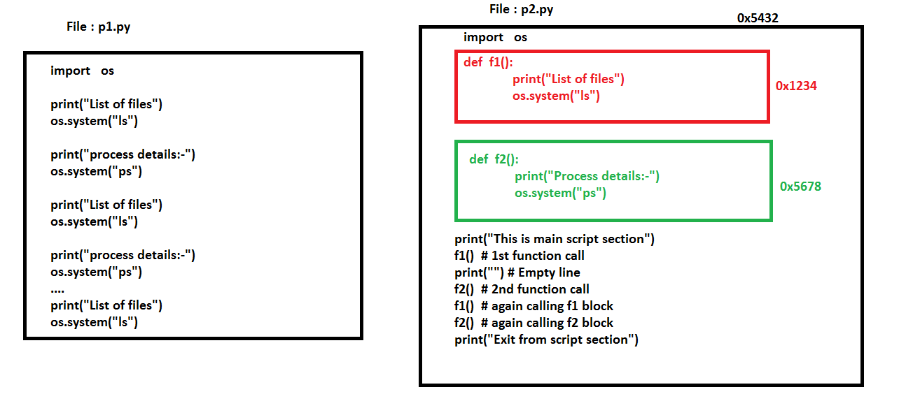

Slide 7
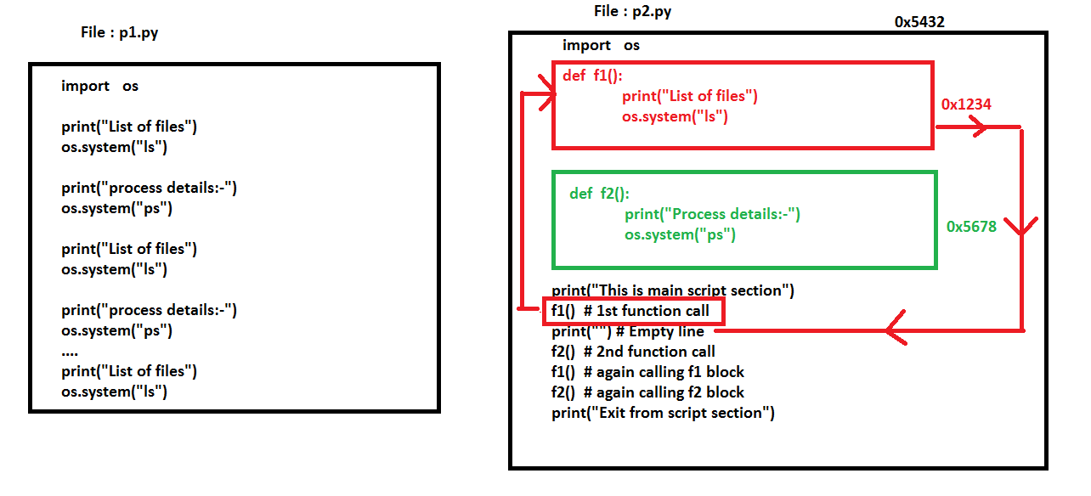

Slide 8
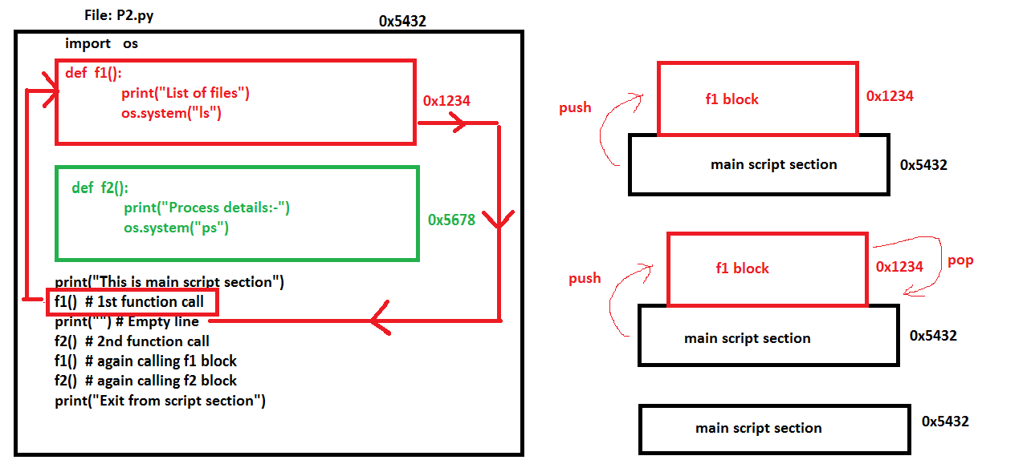
1
2
1
2

Slide 9
Function call with arguments
In function call, we can pass any type of values as arguments.
Syntax :-
def function_name(arg1,arg2,arg3):
Code block
function_name(Value1,Value2,Value3)
# function call with arguments

Slide 10
Function call with arguments
>>> def f1(a1,a2):
... print("Function call with arguments")
... print(type(a1))
... print(type(a2))
... print("Exit from function")
>>> f1(10,2.45)
Function call with arguments
<class 'int'>
<class 'float'>
Exit from function
>>>
>>> f1("abc",[])
Function call with arguments
<class 'str'>
<class 'list'>
Exit from function
>>> f1((),{})
Function call with arguments
<class 'tuple'>
<class 'dict'>
Exit from function
>>>
>>> f1({"S1","S2"},[])
Function call with arguments
<class 'set'>
<class 'list'>
Exit from function
>>>

Slide 11
Function call with arguments
We can call a function by using the following types of formal arguments-
Required arguments def f1(a1,a2,…an)
Default arguments def f2(variable=value)
Variable-length arguments def f3(*args)
Keyword arguments def f4(**kwargs)

Slide 12
Function call with arguments
Required Arguments
Required arguments are the arguments passed to a function in correct positional order.
Here, the number of arguments in the function call should match exactly with the function definition.
Example
>>> def f1(a1,a2):
... print("a1 value:{}\ta2 value:{}".format(a1,a2))
>>> f1(10,1.334) # function call with 2 arguments(int,float)
a1 value:10 a2 value:1.334
>>> f1("AB",["D1","D2","D3"]) # function call with 2 arguments(str,list)
a1 value:AB a2 value:['D1', 'D2', 'D3']

Slide 13
Function call with arguments
Default Arguments
A default argument is an argument that assumes a default value if a value is not provided in the function call for that argument.
def function_name(var=value):
code block

Slide 14
Function call with arguments
>>> def f2 (a1=10,a2=2.46):
... print(a1,a2)
...
>>> f2() # empty args
10 2.46
>>> f2("AB") # single args
AB 2.46
>>> f2("AB","SAB")
AB SAB
>>>
>>> def f3(user="root",port=22):
... print(user,port)
...
>>> f3() # empty args
root 22
>>> f3("userA") # single args
userA 22
>>> f3("userA",120)
userA 120
>>>

Slide 15
>>> def display (user,passwd, ip="127.0.0.1",port=22):
... print("Login name:{}".format(user))
... print("Password:{}".format(passwd))
... print("IP-Address:{}".format(ip))
... print("PORT Number:{}".format(port))
...
>>> display("userA","Welcome") # required arguments
Login name:userA
Password:Welcome
IP-Address:127.0.0.1
PORT Number:22
>>> display("userA","Welcome","10.20.30.40") # required arguments and default args
Login name:userA
Password:Welcome
IP-Address:10.20.30.40
PORT Number:22
>>> display("userA","Welcome","10.20.30.40",1240) # required arguments and default args
Login name:userA
Password:Welcome
IP-Address:10.20.30.40
PORT Number:1240

Slide 16
Function call with arguments
Variable-length Arguments
You may need to process a function for more arguments than you specified while defining the function.
These arguments are called variable-length arguments and are not named in the function definition, unlike required and default arguments.
def f1(*args):
code block

Slide 17
>>> def f1(*a1): # variable length arguments
... print(type(a1))
... print(a1)
...
>>>
>>> f1() # call with empty argument
<class 'tuple'>
()
>>> f1(10,2.34,"data") # call with args
<class 'tuple'>
(10, 2.34, 'data')
>>>
>>> f1(10,2.34,"data",["D1","D2","D3"]) # call with args
<class 'tuple'>
(10, 2.34, 'data', ['D1', 'D2', 'D3'])
>>>

Slide 18
>>> def f1(a1,a2=100,*a3): # required args,defaultargs,variablelength args
... print("A1:{}".format(a1)) # required args
... print("A2:{}".format(a2)) # default value
... print("A3:{}".format(a3)) # variable length args-tuple
>>> f1("ab")
A1:ab
A2:100
A3:()
>>> f1("ab","Test")
A1:ab
A2:Test
A3:()
>>> f1("ab","Test","report1","report2","report3")
A1:ab
A2:Test
A3:('report1', 'report2', 'report3')

Slide 19
Function call with arguments
Keyword Arguments
Keyword arguments are related to the function calls. When you use keyword arguments in a function call, the caller identifies the arguments by the parameter name.
This allows you to skip arguments or place them out of order because the Python interpreter is able to use the keywords provided to match the values with parameters.
def f1(**kwargs):
code block
f1(variable=value)

Slide 20
>>> def f1(**a1): # keyword arguments
... print(type(a1))
... print(a1)
>>>
>>> f1() # empty argument
<class 'dict'>
{}
>>>
>>> f1(name="root",db="mysql",user="root") # keyword arguments
<class 'dict'>
{'name': 'root', 'db': 'mysql', 'user': 'root'}
>>>
>>> def f1(**kwargs):
... for v in kwargs.keys():
... print("{}\t{}".format(v,kwargs[v]))
>>> f1(name="root",db="mysql",user="root") # keyword arguments
name root
db mysql
user root

Slide 21
>>> def display(a1,a2=100,*a3,**a4):
... print(a1) # required argument
... print(a2) # default argument
... print(a3) # variable length args
... print(a4) # keyword argument
...
>>> display("AB") # required argument
AB
100
()
{}
>>> display("AB","TEST1") # required and default argument
AB
TEST1
()
{}
>>> display("AB","TEST1","TEST2","TEST3","TEST4")
AB
TEST1
('TEST2', 'TEST3', 'TEST4')
{}
display ("AB","Test1","Test2","Test3","Test4",user="root",passwd="Welcome",port=80)
AB
Test1
('Test2', 'Test3', 'Test4')
{'user': 'root', 'passwd': 'Welcome', 'port': 80}
>>>

Slide 22
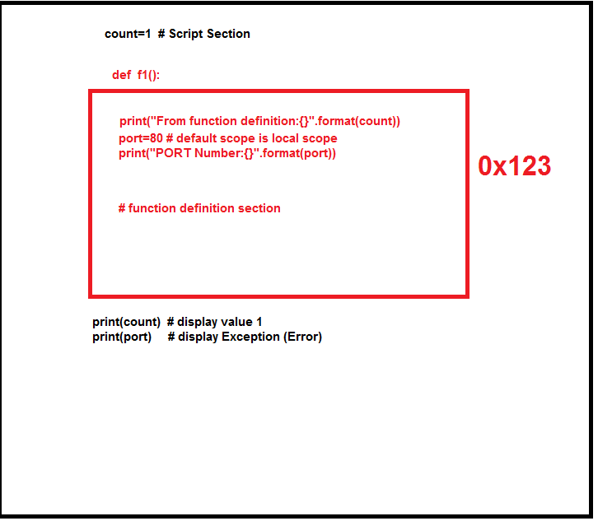
Scope
>>> count=1 # Script section
>>> def f1():
... print("From function definition:{}".format(count))
... port=80 # default scope is local scope
... print("PORT Number:{}".format(port))
...
>>> f1() # function call
From function definition:1
PORT Number:80
>>> port # variable port is not defined in script section
Traceback (most recent call last):
File "<stdin>", line 1, in <module>
NameError: name 'port' is not defined
>>>

Slide 23
global
Global keyword is a keyword that allows a user to modify a variable outside of the current scope.
Global keyword is used inside a function only when we want to do assignments or when we want to change a variable.

Slide 24
Rules of global keyword
If a variable is assigned a value anywhere within the function’s body, it’s assumed to be a local unless explicitly declared as global.
Variables that are only referenced inside a function are implicitly global.
We Use global keyword to use a global variable inside a function.
There is no need to use global keyword outside a function.
>>> def f1():
... global port
... port=80
...
>>> f1() # function call
>>> print(port) # global value
80
>>>

Slide 25
return
A return statement is used to end the execution of the function call and “returns” the result (value of the expression following the return keyword) to the caller.
Return statement can not be used outside the function.
In python default return value is None.
>>> def f1():
... print("Hello")
...
>>> rv=f1()
Hello
>>>
>>> rv
>>>
>>> rv == None
True
>>>

Slide 26
python supports all types of return values
>>> def f1():
... return "abc" # string
...
>>> f1()
'abc‘
>>> def f2():
... return 1.355 # float
...
>>> f2()
1.355
>>> def f3():
... return True # boolean
...
>>> f3()
True
>>> def f4():
... return ["D1","D2","D3"] # list
...
>>> f4()
['D1', 'D2', 'D3']
>>> def f5():
... return ("T1","T2") # tuple
...
>>> f5()
('T1', 'T2')
>>> def f6():
... return {"K1":"V1","K2":"V2"} # dict
...
>>> f6()
{'K1': 'V1', 'K2': 'V2'}
>>>
>>> def f7():
... return {"K1","K2",12,3,4,5.45} # set
...
>>> f7()
{3, 4, 'K2', 12, 'K1', 5.45}
>>>

Slide 27
Returning Multiple Values
In Python, we can return multiple values from a function.
In python function returns more than one value means the default type will be tuple(immutable).
>>> def f1():
... return 10
...
>>> type(f1())
<class 'int'>
>>>
>>> def f1():
... return 10, # more than one value,separated by ,(comma)
...
>>> type(f1())
<class 'tuple'>
>>>

Slide 28
>>> def f1():
... return 10,3.45,"ab",["D1","D2"],("T1","T2"),{"K1":"V"}
...
>>> type(f1())
<class 'tuple'>
>>> f1()
(10, 3.45, 'ab', ['D1', 'D2'], ('T1', 'T2'), {'K1': 'V'})

